Slide 1
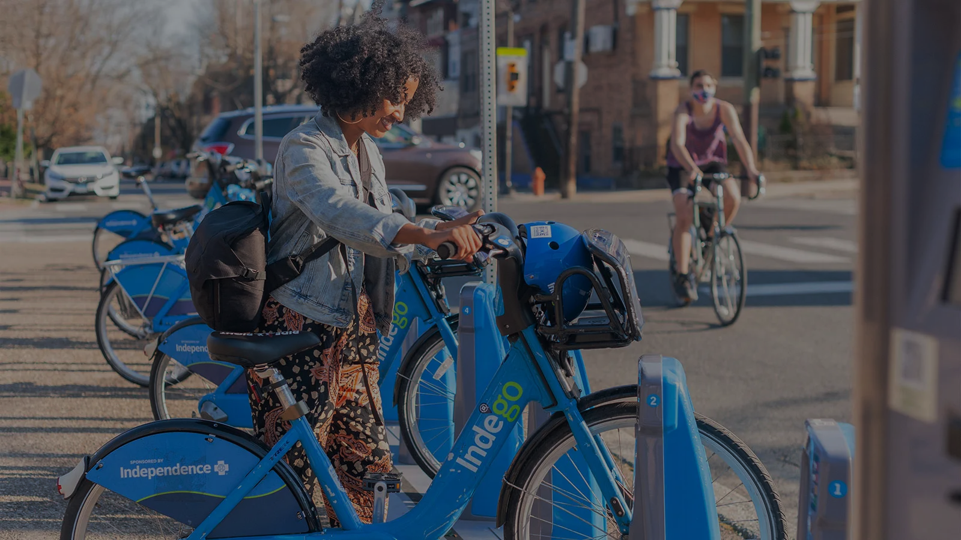

BIKERS COMPANY ANALYSIS
By Iheoma Sunday-Emenike

Slide 2

Table of contents
Introduction
What Problem do we seek to solve?
Questions
Answer 1
Answer 2
Answer 3
conclusion
Recommendation
Analysis and Findings

Slide 3

Introduction
Cyclistic is a bikers’ company in Chicago.
This company have a bike-share program that features more than 5,800 bicycles and 600 docking stations.
They have about a total of 3,879,821 users in their program ranging from members to customers.
They believe that the company success is dependent on maximizing their membership.

Slide 4

1. Why are their customers not members?
2. Ways in which we can make their customers to become members.
What Problem do we seek to solve?

Slide 5
Questions
How many customers and members are there in the bikers’ company?
What station is used most as an end station?
What station is used most as a start station?
Tool used:
Python for Data analysis

Slide 6
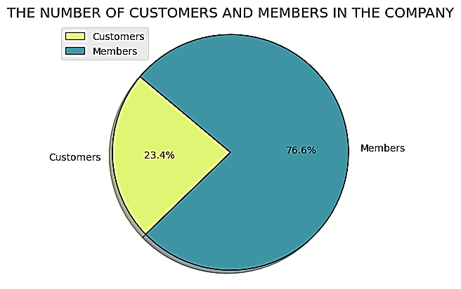
Answer 1: Customers and Members in the Bikers’ company
Members make up 76.6% (2973868) of the users while Customers make up 23.4%(905953) of the users
Summarily, we can see that the company has more members than customers from the above chart

Slide 7
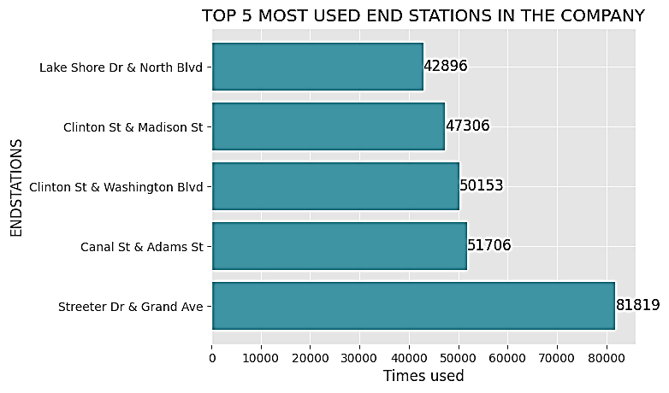
Answer 2: Frequently used End Stations in the company
From the analysis, the top five (5) End Stations mostly used were recorded.
Streeter Dr & Grand Ave had the highest number of times used - 81819

Slide 8
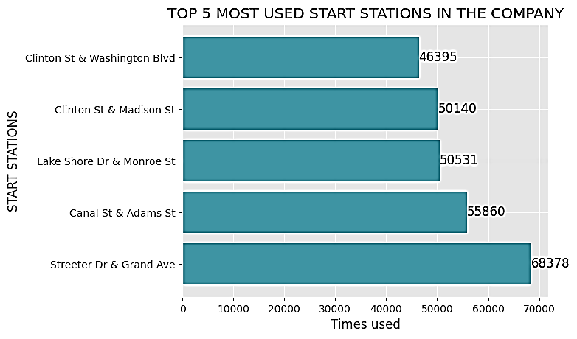
Answer 3: Frequently used Start Stations in the company
From the analysis, the top five (5) Start Stations mostly used were recorded.
Streeter Dr & Grand Ave had the highest number of times used - 68378

Slide 9
ANALYSIS AND FINDINGS
Cyclistic Bikers’ company have flexible pricing plans which are:
Single-ride passes
Full-day passes
Annual membership
Users who purchase the single–ride passes and full-day passes are termed Customers. This is owing to the fact that most of the customers can’t afford the annual membership payments.
This here is the reason why Customers cannot be members

Slide 10
RECOMMENDATIONS
Most of the Customers have been observed to use this service because of their mobility needs
As such, Cyclistic Bikers’ company should include monthly membership pricing plan
With this options open, there are customers who can afford the monthly plans, others will jump at the offer because of how much they need it
Thereby, resulting in most of the Customers switching to membership

Slide 11

QUESTIONS

Slide 12

THANK YOU

